Slide 1
Chapter 5 INTRODUCTION TO SYSTEMS FAILURES THINKING
Z.Hande ÜRETÜRK
IS 739
27.03.2017

Slide 2
Agenda
Introduction / Definition of Failure
Implications of Systems Failures
Comparative Models
The Formal System Paradigm
The Control Paradigm
The Communication Paradigm
Engineering Reliability Paradigms
Human Factors Paradigms
Questions

Slide 3
Introduction
Any system is capable of failure. System failures can be dramatic or have serious consequences.
Understanding SYSTEM FAILURES improves the SYSTEMS and prevents future FAILURES.
What is a Failure?
Definition : “The condition or fact of not achieving the desired end or ends.”
People would claim to recognize a failure when confronted with one.

Slide 4
Introduction (cont.)
Failure cases
Car breakdown
Decrease in sales
Power failure
Breakdown in pay negotiations
Server crash

Slide 5
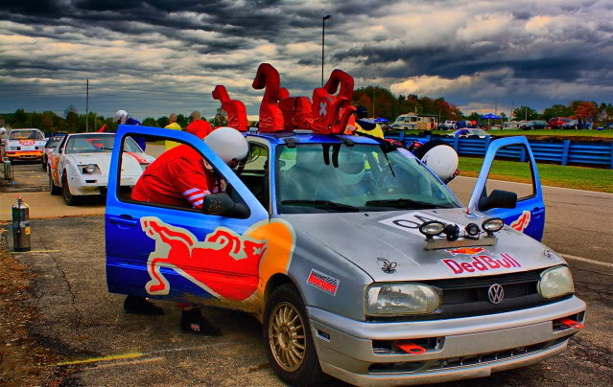
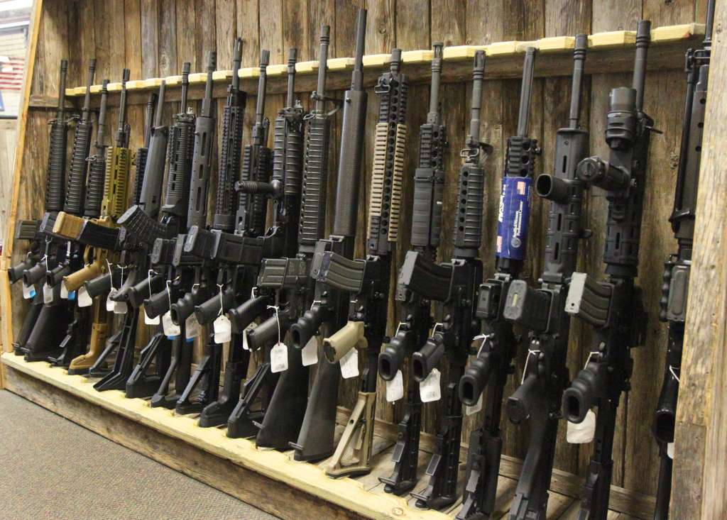
Introduction (cont.)
Your failure may be considered as a success by someone else. Perception of failure depends on your point of view.
Failure of your car turns into a success for the competitors in a rally.
A war is an opportunity for the black marketers whereas citizens seems war as a disaster.

Slide 6
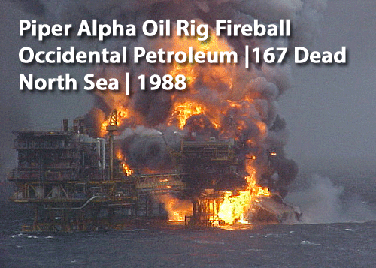
Introduction (cont.)
In some cases, the effects of a SYSTEM FAILURE can be defines as “disaster” and results in injuries, loss of life or material destruction.
Hard system failure (disaster)
Piper Alpha oil rig accident, 1988
167 workers died

Slide 7
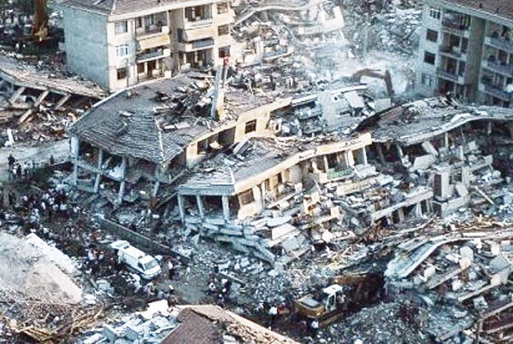
Introduction (cont.)
In addition to hard system failures, natural system failures also becomes catastrophic;
Earthquake in Gölcük (1999)
~ 18K people dead

Slide 8
Implications of System Failures
When a failure detected, an “instant diagnosis” is done by the people and the failure is attributed to a “single cause”.
However, in general, failures arise from multiple causes such as “human error” and “technical failure”.
Example; (inadvertence) – Putting your feet on the accelerator instead of brake.
Causes: receiving inadequate information and training.

Slide 9
Comparative Models
Anticipation and prevention of an apparent failure requires understanding of one or more SYSTEMS conceived to be relevant to that failure.
Paradigms (models) are useful tools for understanding characteristics of a SYSTEM.
Absence of a desired paradigm in a failure situation may helps us understanding the causes of the failure.

Slide 10
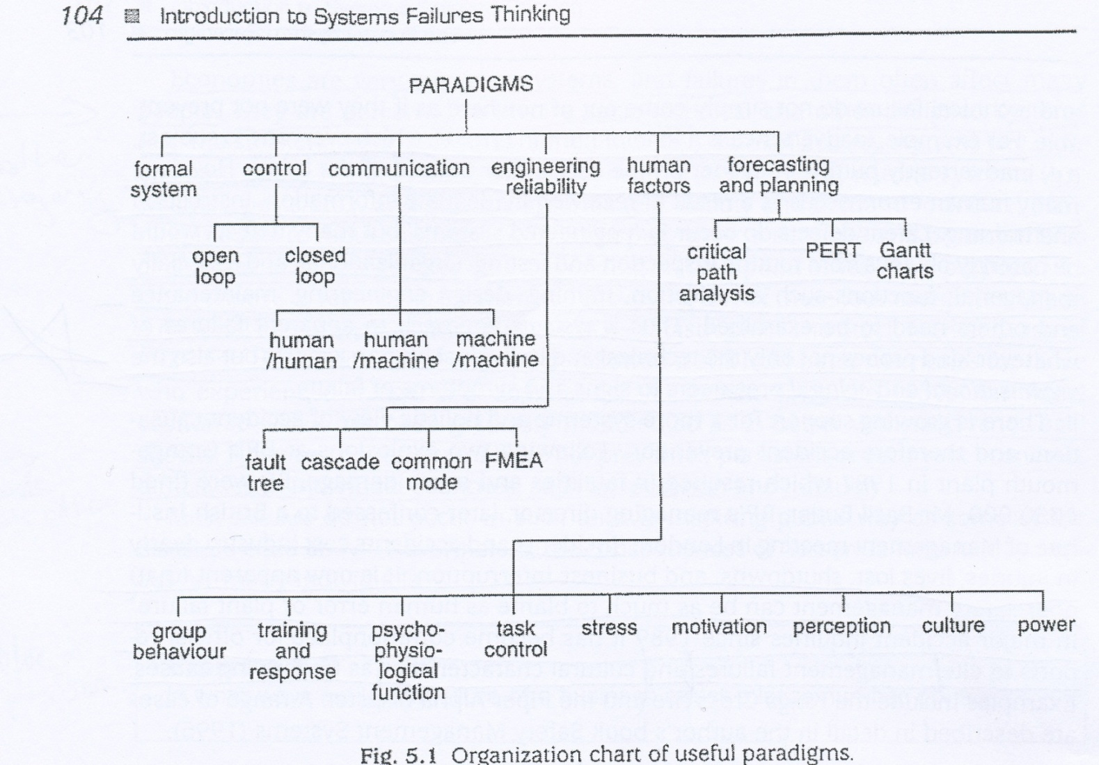
Comparative Models (cont.)

Slide 11
The Formal System Paradigm (FSP)
FSP is essential to any system failure study of a situation in which human activity forms a part.
Should always be the first model used for comparison. Use of the FSP can also often point towards other models that would be useful comparison. For example an apparently defective control element implicated by FSP comparison could then be compared with the control paradigm to study more detail.
Question: was there a SYSTEM at all immediately before the apparent failure in the situation being examined?

Slide 12
The Formal System Paradigm (FSP) (cont.)
Board of Directors
(Issues overall instructions, costs and revenue targets)
(control)
Sales
Finance
(Monitors the performance of departments and feeds data to the board)
(operations)
(monitoring)
Absence of any sub-system listed above is a classic indicator of SYSTEM FAILURE.

Slide 13
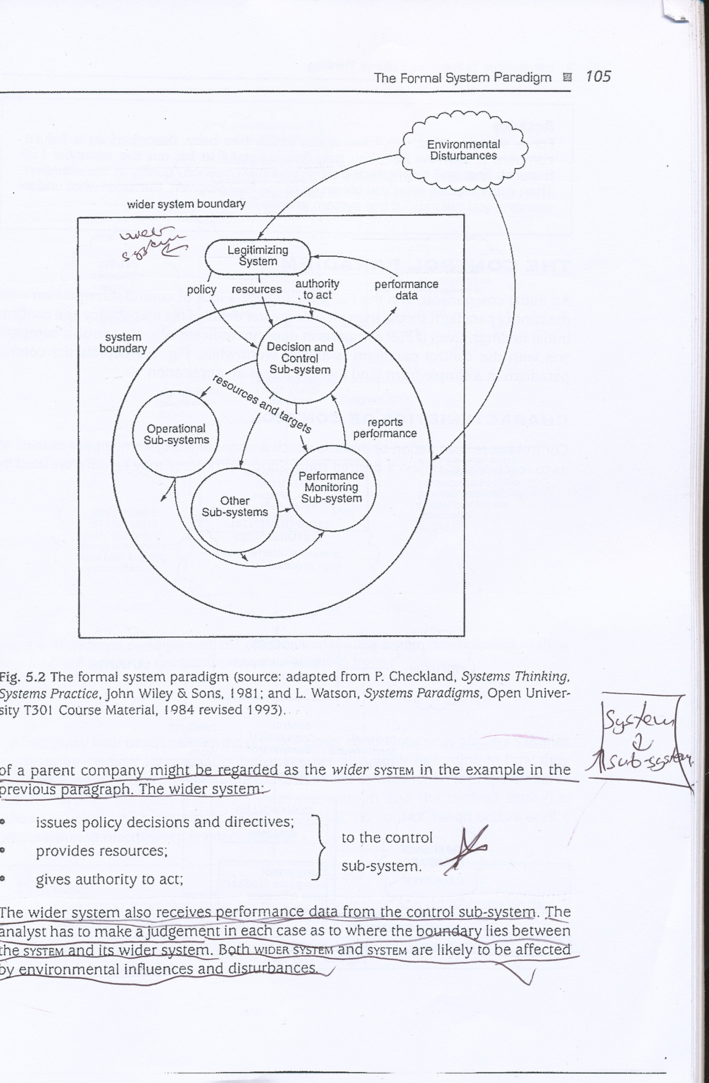
The Formal System Paradigm (FSP) (cont.)
FSP requires following components in a system:
A control/decision-making subsystem
An operational subsystems
A performance monitoring subsystem

Slide 14
The Control Paradigm
Comparison with the control paradigm should provide great detail of the inadequacy and confirm initial findings.
Control is an action or process which a SYSTEM or subsystem applies to itself so as to reach and maintain a desired state.

Slide 15
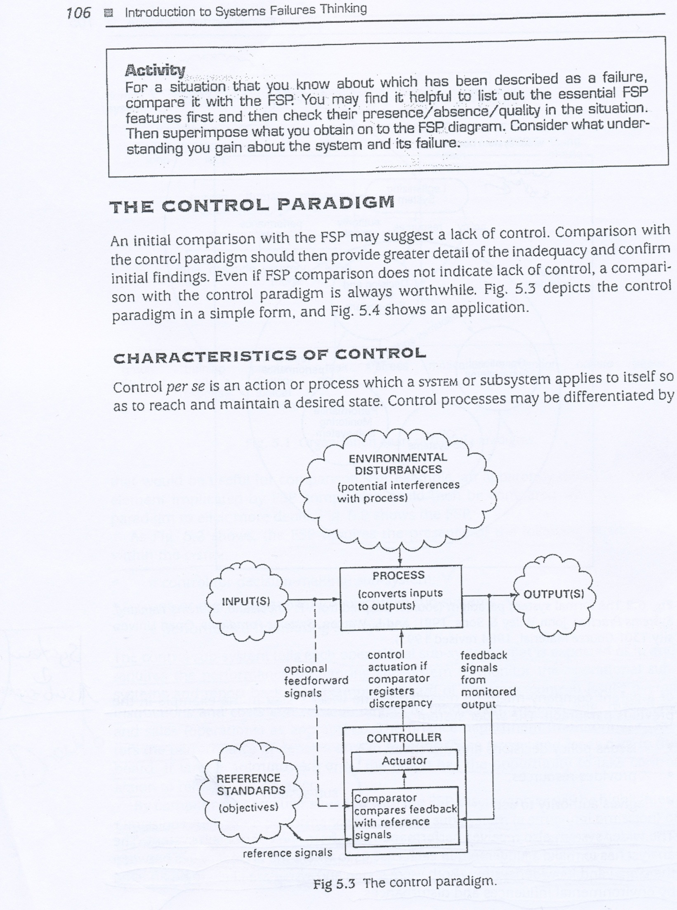
The Control Paradigm (cont.)

Slide 16
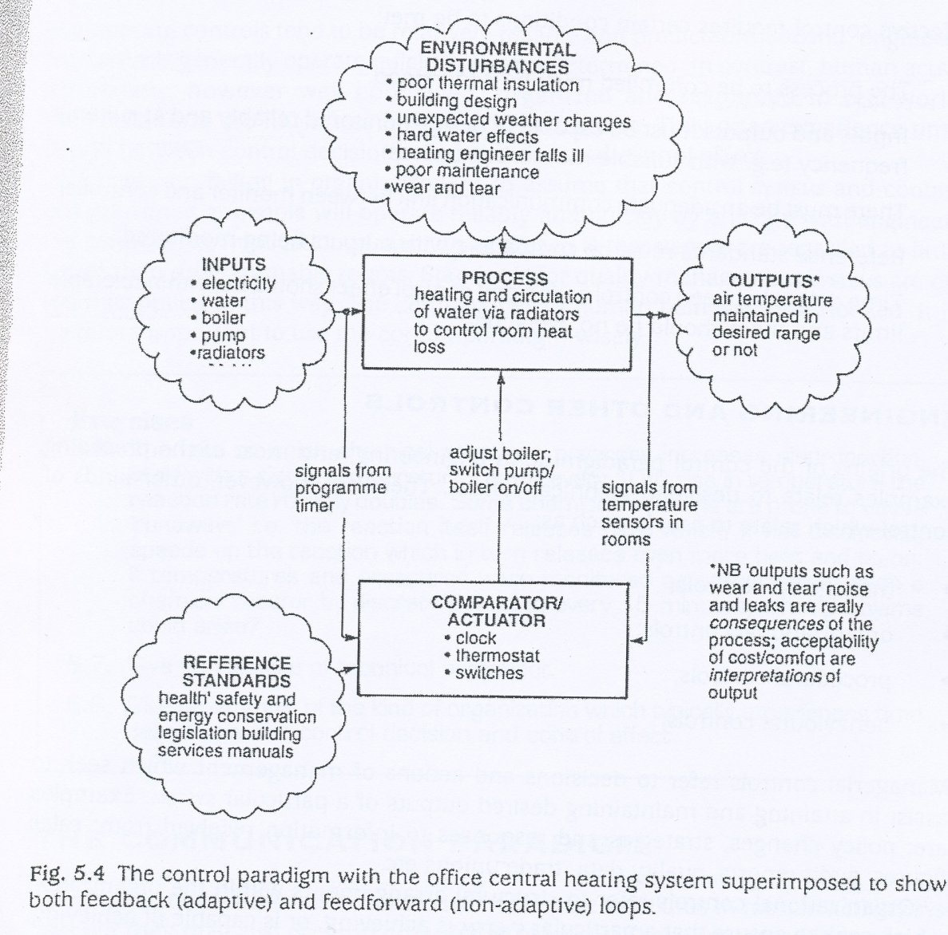
The Control Paradigm (cont.)

Slide 17
The Control Paradigm (cont.)
Effective control requires certain conditions to be met;
The process to be controlled must be understood.
Inputs and outputs must be capable of being monitored.
A communication link between controller and monitor.
Reference standards must be compatible with outputs.
Time delays between control action and control effect should be within tolerable limits.

Slide 18
The Communication Paradigm
Communication failures are typical failures in human activity systems but they also occur in other types of systems.
Human-Human Communication
Frequently quoted example of communication failure between humans concerns the story of the telephone request from an army commander to headquarters;

Slide 19
The Communication Paradigm (cont.)
Commander
- “Send reinforcements, we’re going to advance
Young Corporal understand as
“Send three-and-fourpence, we’re going to a dance”
Causes: language difficulties & noise

Slide 20
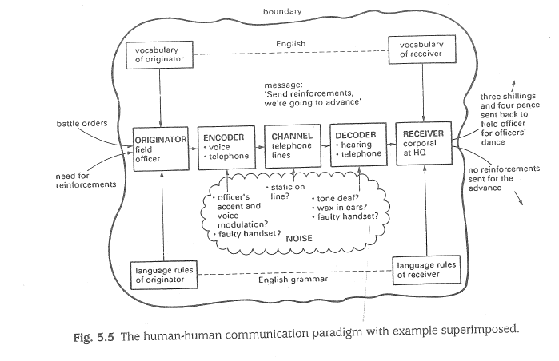
The Communication Paradigm (cont.)

Slide 21
The Communication Paradigm (cont.)
Human-Machine Communication
As mentioned in H2H communication, encoding and decoding are also features of H2M communication.
Cause: noise
In Three mile Island nuclear power station accident, an indicator light in the control room was masked by a caution tag. The operator reads temperature as 235F where the actual temp was 285F.

Slide 22
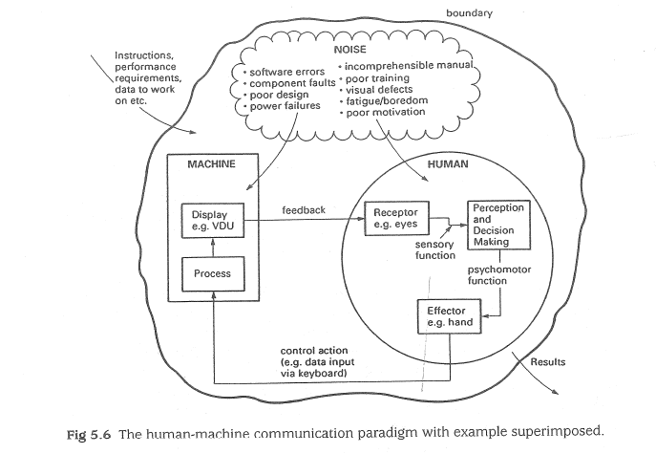
The Communication Paradigm (cont.)

Slide 23
The Communication Paradigm (cont.)
Machine-Machine Communication
Electronic signals sent & received between machines over the networks.
Cause: noise, information load
Example;
SEAQ in London Stock Exchange (1986)
Information load on SEAQ blocked the system.

Slide 24
Engineering Reliability Paradigms
Engineering reliability seeks to ensure that there is an acceptable period of time before failure occurs in “engineered systems”.
Measures of Reliability
Reliability: degree of confidence which can be placed in a system fulfilling its duties in service.
In engineering, reliability is a probability value between 0.0 to 1.0.

Slide 25
Engineering Reliability Paradigms (cont.)
Factors affecting systematic failures;
Poor manufacturing methods.
Lack of quality control.
Outcomes of Component Failure
Since a system is composed of interconnected sub-systems, component failures may lead to SYSTEM FAILURE.
System reliability depends on component reliability.

Slide 26
Engineering Reliability Paradigms (cont.)
Duplication of critical components increases system reliability.
Technical Failure Categories
The design is inadequate for the expected forces and environmental conditions.
The component or structure is not made to the design drawings or specification.
Greater loading or environmental conditions.
Maintenance and inspections procedures are faulty or absent.

Slide 27
Engineering Reliability Paradigms (cont.)
Faulty Trees
Faulty trees chart the conditions necessary for a particular apparent failure and are used to identify or predict how such a failure might occur.
Each tree is built up as a series of levels or hierarchies as in an organization chart and levels are linked by logic gates.

Slide 28
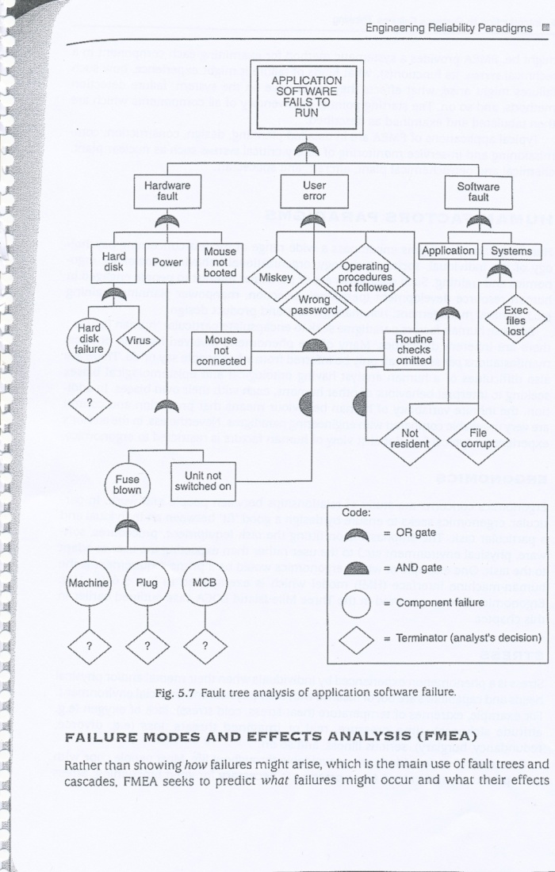
Engineering Reliability Paradigms (cont.)

Slide 29
Engineering Reliability Paradigms (cont.)
Cascade Paradigm
The cascade models a chain of failures, domino effect.
A more useful cascade model incorporates multiple and looping failures in which the SYSTEM of failures enhances itself in a chain reaction or snowball.

Slide 30
Engineering Reliability Paradigms (cont.)
Common Mode
All components have a common fault.
Cause: poor design, manufacturing faults not identified by quality control procedures.
Example: Whole batches or models of car being recalled after the manufacturer has discovered a design fault.

Slide 31
Engineering Reliability Paradigms (cont.)
Failure Modes and Effects Analysis (FMEA)
Instead of showing how failures occur, FMEA tries to predict result or effects of a failure.
FMEA provides a systematic method for examining each component in a technical SYSTEM, its function(s), types of possible failures and their effects.
FMEA applications: planning, design, construction and service monitoring.

Slide 32
Human Factors Paradigms
Covers a wide range of models;
Psychology of individual,
Social psychology,
Organizational behavior,
Sociology,
Ergonomics & training.
Ergonomics
Study of relationships between people and work. Seeks to ensure by design a good “fit” between an individual and a task.

Slide 33
Human Factors Paradigms (cont.)
Stress
Stress is a phenomenon experienced by individuals when their mental or physical needs and capabilities are out of balance with their physical or social environment.
Motivation
Goals which people have and the mental process involved in seeking to attain them. Affects human decision and a factor of SYSTEM FAILURE.

Slide 34
Human Factors Paradigms (cont.)
Organizational Culture
Metaphor for the complexity of shared beliefs, values, attitudes, behaviors and artefacts which characterize a group of people. (e.g. nation, region, company…)
Power Relations
Analysis of an organization’s culture focuses on shared characteristics of its members.
Concerns differences of interests between and among groups and individuals and the political processes.

Slide 35
Thank you for your listening.
QUESTIONS

